Slide 1

Drive system for an electric Go-kart
Group PED-841

Slide 2

Introduction
Group PED 841
Mihai Rusu
Aitor Teran
Nicolai Fransen
Nicolas Murguizur Bustos
Estefania Ruiz
Faheem Ahmad

Slide 3

Agenda
Motivation & objectives
Hardware
Control
Firmware
Test results
Conclusion
Demonstration

Slide 4
Motivation
Slide
of 52
Develop a control algorithm for the power train of an electrical go-kart
Objectives
Design and simulation
Implement FOC in a digital signal processor (DSP)
Interface board
Inverter tests
Modelling the battery pack
Experimental setup
Project management
Mihai

Slide 5
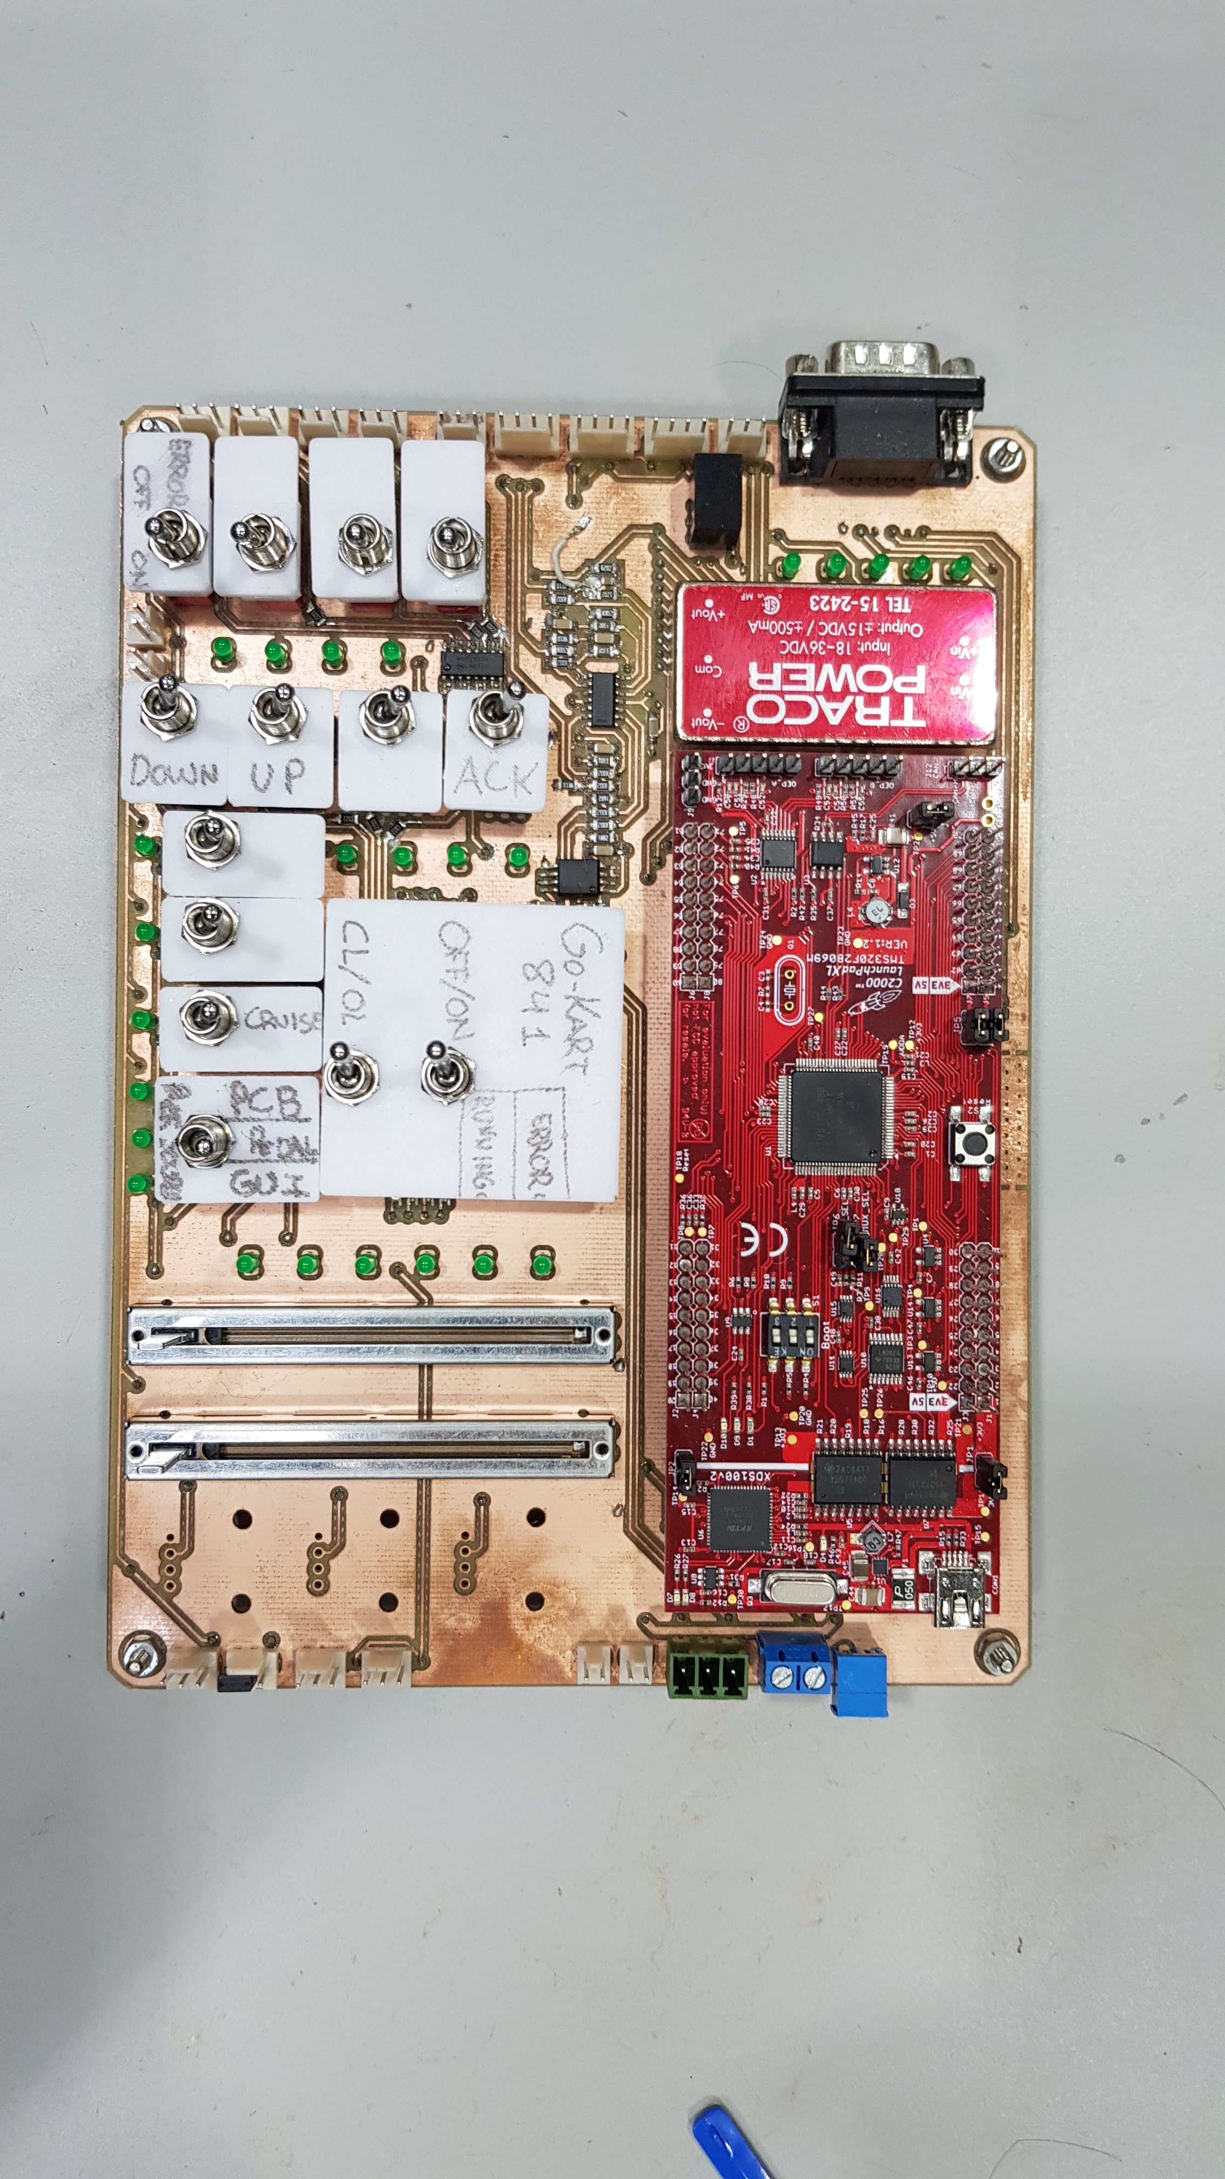
Hardware
Notes:
Motivation
Existing problems
What is a MIC
Why a MIC
Problem statement

Slide 6
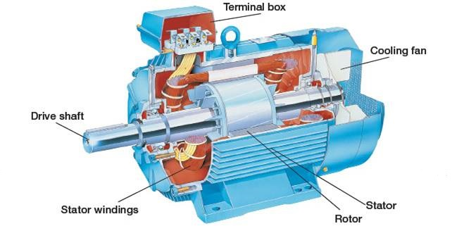
TSA170-210-038 Sauer Danfoss
Slide
of 52
Induction machine nominal parameters
Power | P_{n} | 5.3 [kW]
Phase voltage | U_{n} | 13.85 [V]
Phase current | I_{n} | 189 [A]
Power factor | PF | 0.76
Stator frequency | f_{n} | 58 [Hz]
Mechanical shaft speed | ω_{n} | 1685 [rpm]
Electromagnetic torque | T_{n} | 30.04 [Nm]
Mihai

Slide 7
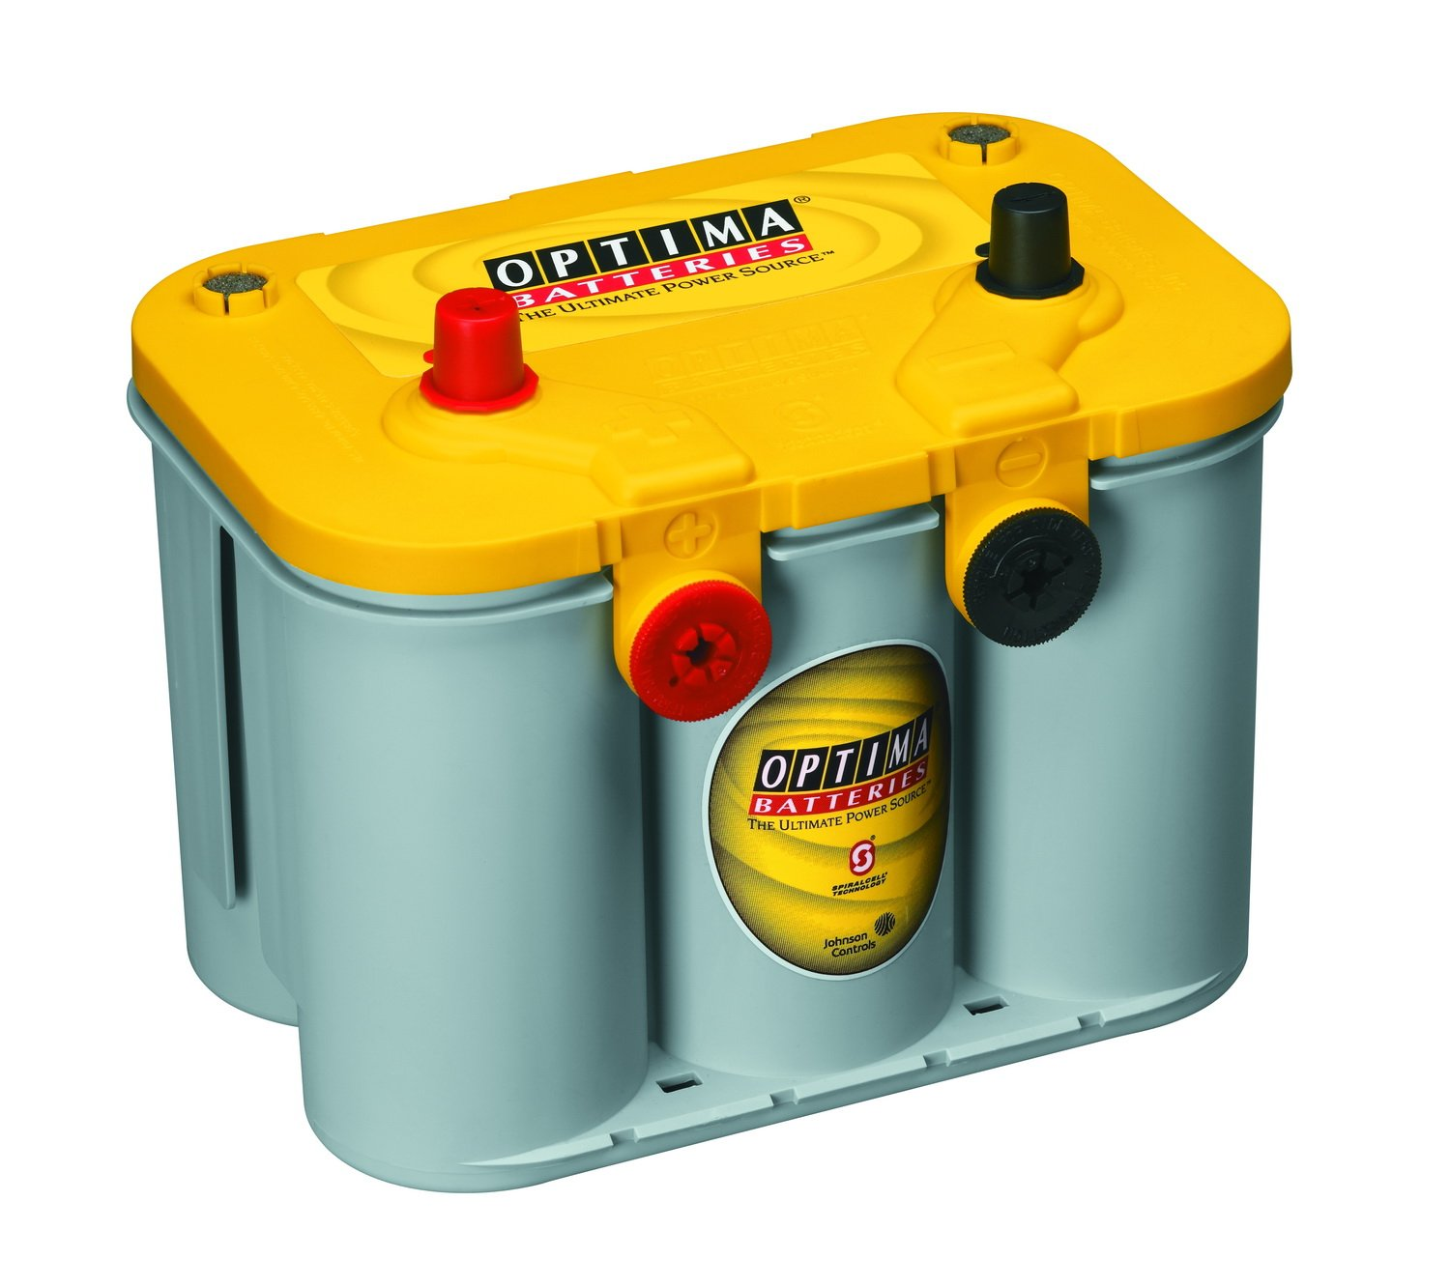
Batteries
Slide
of 52
Mihai

Slide 8
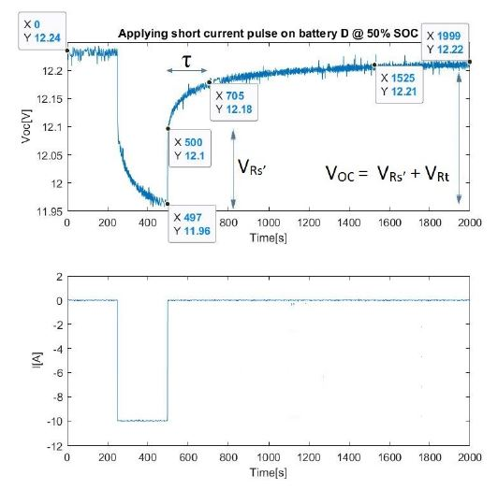
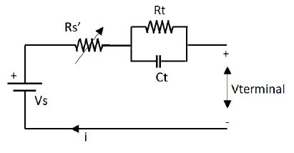
Batteries – obtaining parameters
Slide
of 52
Why short pulse test?
Points of interest
Goal
Mihai

Slide 9
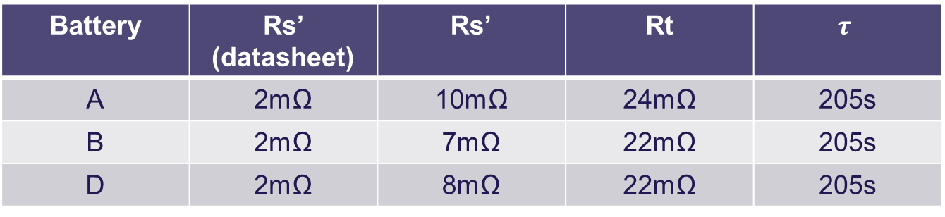
Batteries – experimental parameters
Slide
of 52
Battery | Rs’ (datasheet) | Rs’ | Rt | $$τ$$
A | 2mΩ | 10mΩ | 24mΩ | 205s
B | 2mΩ | 7mΩ | 22mΩ | 205s
D | 2mΩ | 8mΩ | 22mΩ | 205s
Battery | Rated capacity | Charging capacity | Discharging capacity | Efficiency
A | 55Ah | 14.4Ah | 14.4Ah | 80%
B | 55Ah | 35Ah | 33Ah | 94.2%
D | 55Ah | 19.3Ah | 17.7Ah | 91.7%
Mihai

Slide 10
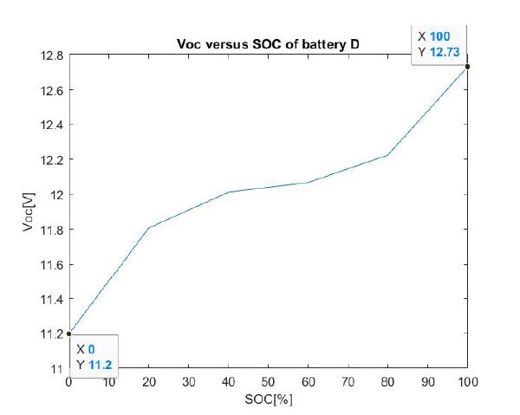
Batteries – SOC vs. VOC curve
Slide
of 52
Observations
How is obtained?
Mihai

Slide 11
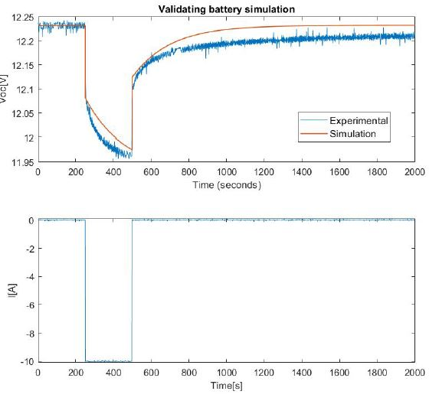
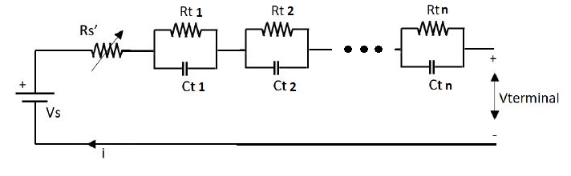
Batteries – simulation result
Slide 11
of 52
Observations
Is it satisfactory?
What can be improved?
Mihai

Slide 12
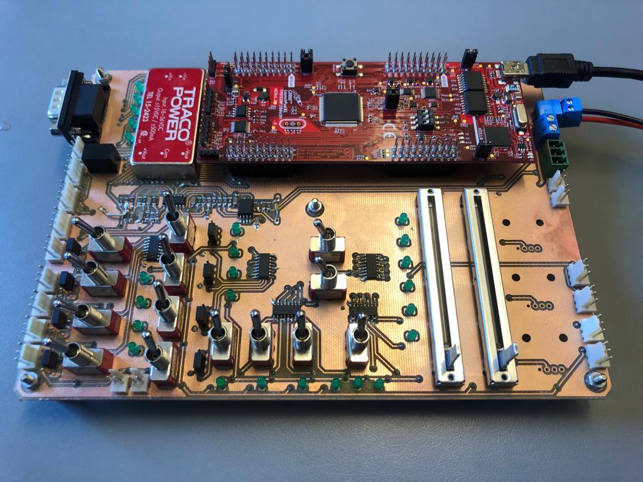
Interface Board
Slide
of 52
Sections of board
Power supply
DSP development kit
Reference selection
Faheem

Slide 13
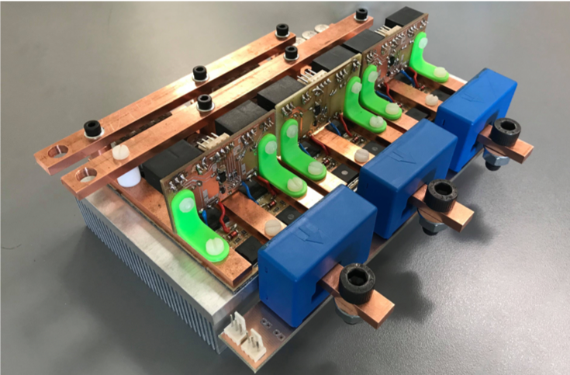
Inverter
Slide
of 52
Inverter Electrical Characteristics
Power capability : 7.3kW
DC link voltage : 36V
Switching frequency : 20kHz
MOSFET Used
Infineon OptiMOSTM : 80V 300A
Package type : PG-HSOF-8-1
Max. allowed T_{j} : 175℃
Faheem

Slide 14
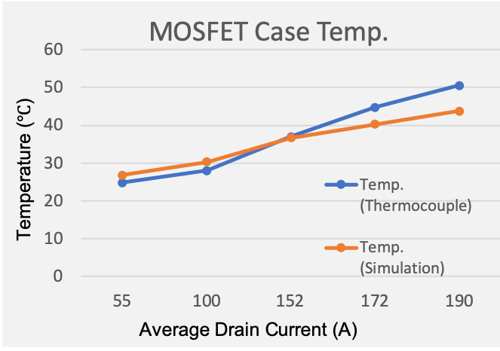
Inverter thermal test
Slide
of 52
Inverter case temperature test at different operating condition up to rated values
DC link voltage (V) | Average drain current (A) | Temp. (Thermocouple) (℃) | Temp. (Simulation) (℃)
12.5 | 55 | 24.8 | 26.8
18 | 100 | 28 | 30.3
24 | 152 | 37 | 36.7
33 | 172 | 44.8 | 40.3
38 | 190 | 50.5 | 43.8
Faheem

Slide 15
Control of the induction machine

Slide 16
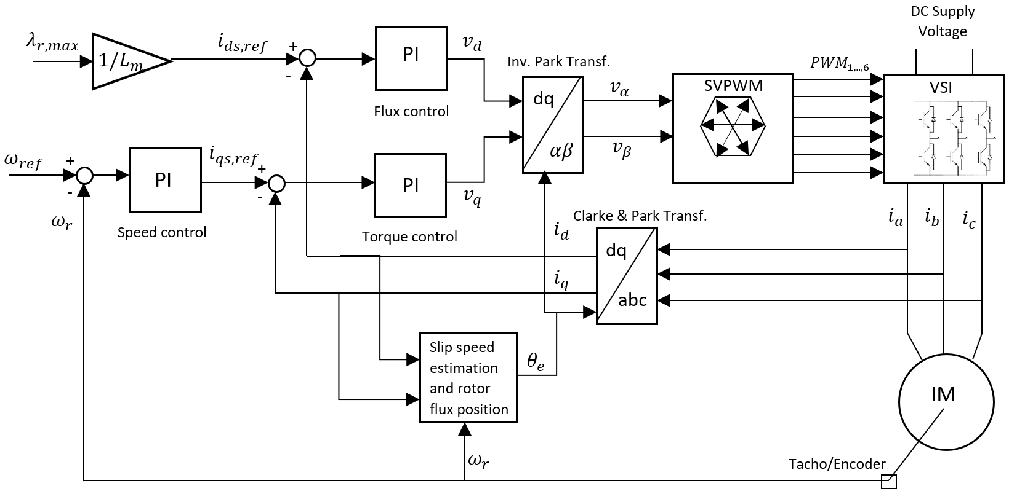
Field Oriented Control (FOC)
Slide
of 52
Estefanía
Notes:
FOC → field orientation in order to achieve independent control of the torque and rotor flux by controlling the stator currents in the dq- reference frame.
Necessary to perform reference frame transformation then the rotor flux field position is found from the rotor mechanical speed and the slip speed.
Two types of control → Torque control (2 PI controllers for torque - iq and flux - id) and Speed control (cascaded controller 3 PIs )
Modulation technique for controlling the gate signals of the VSI → SVPWM
- General block diagram of FOC where we have…..

Slide 17
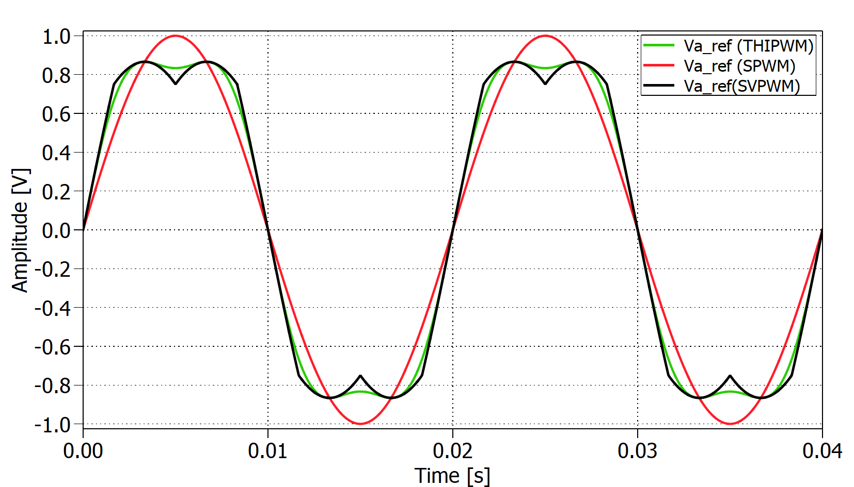
Space Vector Modulation PWM
Slide
of 52
Why SVPWM?
Better performance than SPWM
Output voltage can be increased up to 15% → Better use of $V_{DC}$
Lower THD → higher efficiency
Flexibility to be implemented digitally → DSP
Estefanía
Notes:
Most popular SPWM but has drawbacks as high harmonic distortion
This technique allows to obtain a flattened voltage ref. waveform by reducing the peak voltage by approx 15% compared to fundamental.
Better utilization of Vdc without entering the overmodulation región → low THD
It is decided to select this modulation technique for controlling the VSC of this Project because of these advantages and its flexibility to…
Not mention overmodulation be concise dont explain too much.

Slide 18
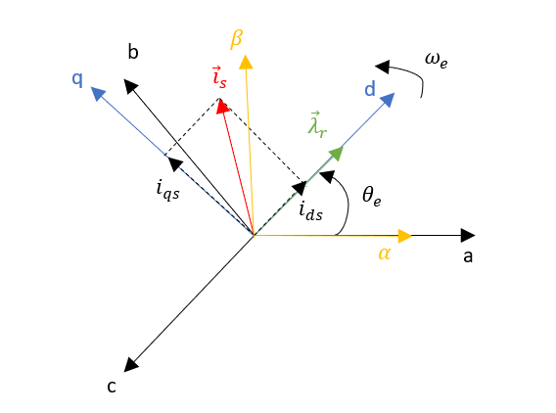
Rotor flux oriented control
Slide
of 52
$$T_{e}= \frac{3}{2}∙p∙L_{m}∙(i_{qs}{∙i}_{dr}− i_{ds}∙i_{qr})$$
Alternate form
$$T_{e}= \frac{3}{2}∙p∙\frac{L_{m}}{L_{r}}∙Im({\vec{i}}_{dqs}∙{\vec{λ}}_{dqr}∗)$$
$${\vec{λ}}_{dqr}∗ =λ_{dr}−jλ_{qr}$$
$$λ_{qr }=0$$
$T_{e}= \frac{3}{2}∙p∙\frac{L_{m}}{L_{r}}∙ λ_{dr }∙i_{qs}=k$ $∙i_{qs}$
$${\vec{i}}_{dqs} =i_{ds}+ ji_{qs}$$
Estefanía
Notes:
Basic idea is to use an arbitrary dq frame where rotor flux is constantly aligned with d-axis as shown on the diagram.
This orientation allows decoupling of the IM torque and flux control variables making it possible to operate the induction machine as a separately excited DC motor.
The general torque equation for an induction machine in the dq frame depends on both iqs and ids however, with FOC by forcing the rotor flux to be in the d-axis rotsting at synchronous speed the q-axis rotor flux becomes zero tghen obtaining the torque as a function of the q-axis current only.
Large Font size in final equation and change kt for k.
The torque is proportional to the q axis current keeping the flux constant!

Slide 19
Rotor flux oriented control
Slide
of 52
Determination of rotor flux position ${(θ}_{e})$
0
$u_{qr}=0= R_{r}∙i_{qr}+ \frac{dλ_{qr}}{dt}+(ω_{e}−ω_{r})$ $∙λ_{dr}$
0
$u_{dr}=0= R_{r}∙i_{dr}+ \frac{dλ_{dr}}{dt}−(ω_{e}−ω_{r})$ $∙λ_{qr}$
Slip speed ($ω_{sl}$)
$$ω_{sl}=\frac{L_{m}}{τ_{r}}∙\frac{i_{qs}}{λ_{dr}}$$
$$ω_{sl}=\frac{1}{τ_{r}}∙\frac{i_{qs}}{i_{ds}}$$
$λ_{dr}={ L}_{m}$ ${∙ i}_{ds}$
Estefanía
Notes:
- 2 different ways of implementing FOC for determining the rotor flux position. Depending on the possibility to measure the rotor shaft position of the IM or not, direct or indirect FOC can be implemented. Indirect FOC → Encoder
From the rotor voltage eq of the IM it is obtained that for rotor flux oriented control the terms containing the rotor flux in the q axis disappear and the difference between the synchronous speed w_e and the shaft’s electrical speed is known as slip speed.
To obtain the rotor flux position the slip speed needs to be estimated from the IM equations. It’s obtained that it is a function of the stator currents in the dq fr.
Explain a bit slower the slip part because I was too fast.

Slide 20
Rotor flux oriented control
Slide
of 52
Determination of rotor flux position ${(θ}_{e})$
$$i_{qs}$$
$$ω_{sl}$$
$$ω_{e}$$
$$×$$
$$\frac{1}{τ_{r}}$$
$$i_{ds}$$
$$+$$
$$÷$$
$$+$$
$$\frac{1}{s}$$
$$θ_{e}$$
$$ω_{r}$$
$$θ_{e}=\int{\left(ω_{sl}+ ω_{r}\right)dt}$$
$$ω_{e}=ω_{sl}+ ω_{r}$$
Estefanía
Notes:
Once the slip speed is estimated, by adding to this speed the rotor speed obtained from the Encoder attached to the shaft, it’s posible to obtain the rotor flux position by integrating the total sum of the speeds.

Slide 21
Rotor flux oriented control
Slide
of 52
Determination of $i_{ds,ref}$
IM rated parameters:
$I_{ph,rated = }189 A$
$U_{ph,rated = }\frac{24}{\sqrt{3}} V$
From the IM equations:
$${\vec{λ}}_{dqr}= \frac{L_{r}}{L_{m}}∙({\vec{λ}}_{dqs} − σ∙{\vec{i}}_{dqs})$$
$$λ_{r,max}=0.047 Wb$$
Constant ${ i}_{ds,ref} \text{up} \text{to} \text{rated} \text{speed}$:
$${ i}_{ds,ref}= \frac{λ_{r,max}}{{ L}_{m}}=123.5 A$$
Estefanía
Notes:
From the nameplate of the induction machine the rated voltage and current is obtained to calculate the stator flux linkage. Then the rated rotor flux linkage is calculated in order to obtain the reference for the d-axis current. The IM will perform as expected up to the rated speed which is around 1600rpm. After that point it would be necessary to weaken the flux in order to keep having a proper control of the IM. The motor will opérate in the field weakening región but this isnt scope od the Project.

Slide 22
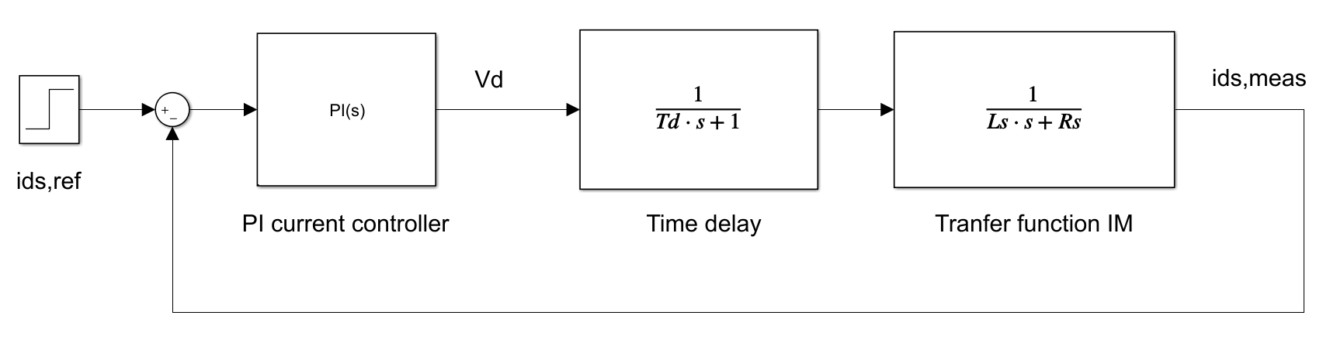
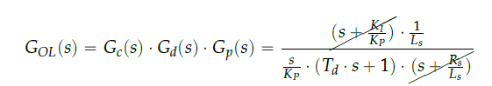
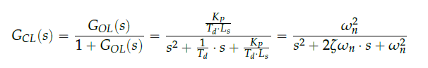

PI current controllers
Slide
of 52
Same PI parameters for $i_{ds}$ and $i_{qs}$
Zero-pole cancellation method:
Overshoot < 2%
$${ K}_{I} = \frac{R_{s}}{{ L}_{s}}∙ { K}_{P}$$
$$ω_{BW} =2 ∙ π∙500 Hz$$
$${ T}_{d} =0.5∙ { T}_{s}=50 μs$$
$${ K}_{P} ={ L}_{s} ∙ { T}_{d} ∙ ω_{n}^{2}$$
Estefanía
Notes:
- The transfer function is the same for the d- and q-axis which means that the current loops for both will be exactly the same.
- The delay appears in the system because of the digital implementation in a microcontroller. The time for sampling the measured signals in the Analog to
Digital Converter (ADC) and the time it takes to perform the control algorithm have to be taken into account. The time delay was reduced as much as possible while programming the microcontroller achieving a total time delay of half a switching period (Td 0.5Ts).
The requirement fot the controller is that the bandwidth should be 500Hz then applying the zero-pole cancellatio nmethod, which consist on placing the controllers zero to cancel the plant’s pole, the Ki is obtain as a fiunction of motor parameters and Kp.

Slide 23
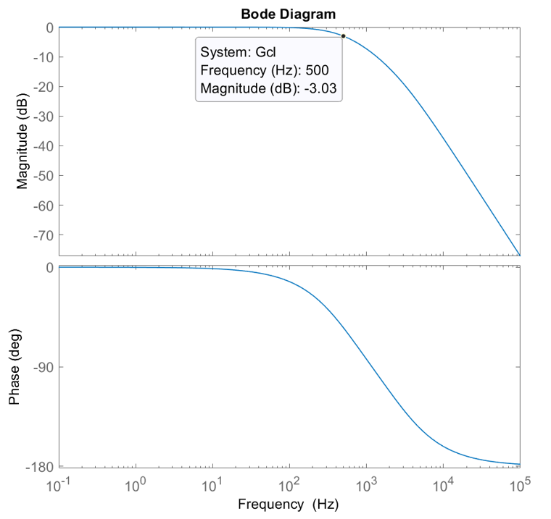
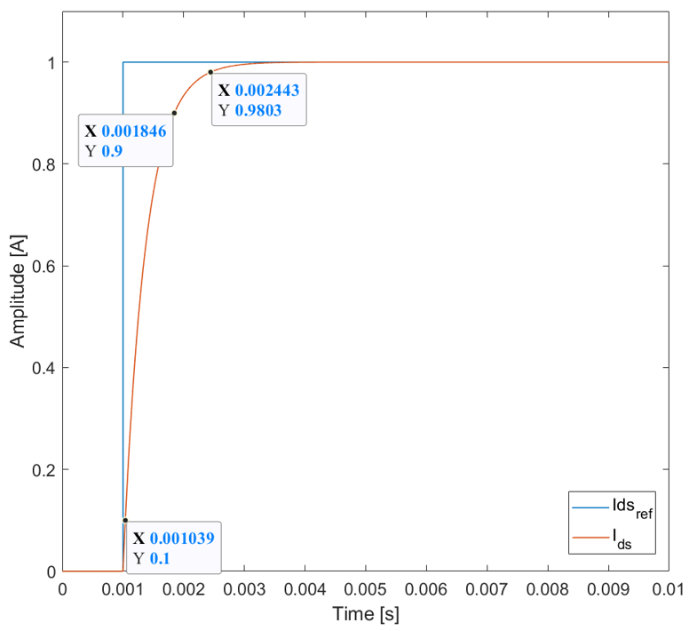
PI current controllers
Slide
of 52
Estefanía

Slide 24
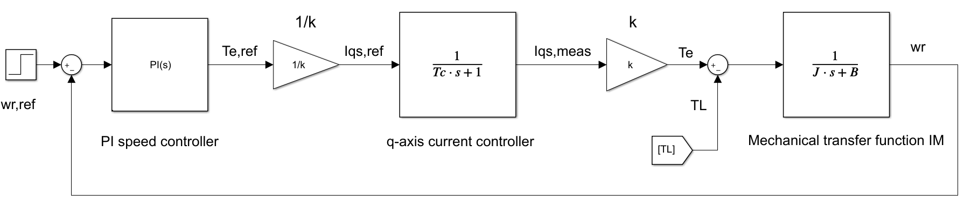
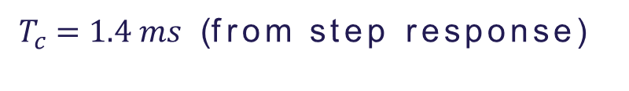
PI speed controller
Slide
of 52
Zero-pole cancellation method:
Overshoot < 5%
$$ω_{BW,ω} =\frac{ω_{BW,c}}{10}=2 ∙ π∙50 Hz$$
$${ K}_{I,ω} = \frac{B}{J}∙ { K}_{P,ω}$$
$${ K}_{P,ω} =J ∙ { T}_{c} ∙ ω_{n}^{2}$$
${ T}_{c} =1.4 ms$ (from step response)
Estefanía
Notes:
- The outer speed loop is governed by the mechanical equation of the induction machine
The closed loop transfer function of the current controller can be reduced to a first order transfer function because the outer speed loop is much slower than the inner loop.
Following the same zero-pole cancellation technique, as done during the design of the current PI controllers, the zero is selected to cancel the induction machine’s pole.

Slide 25
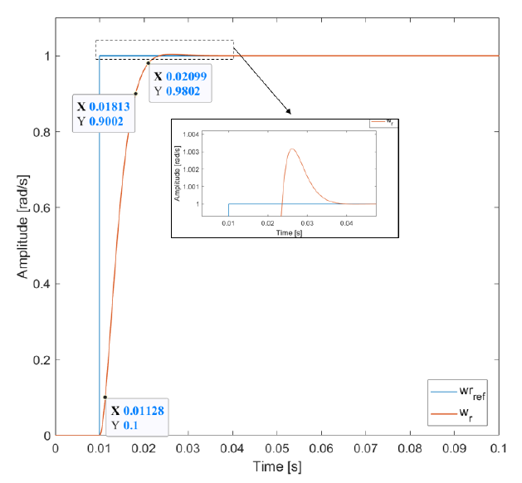
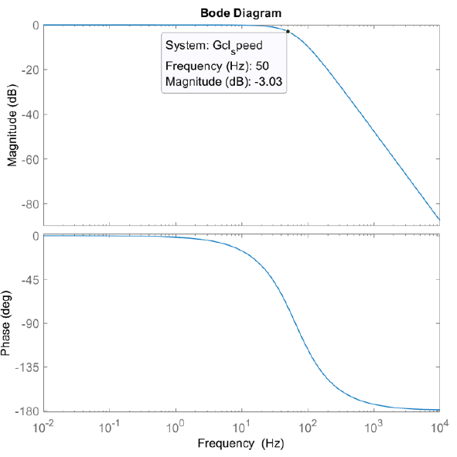
PI speed controller
Slide
of 52
Estefanía

Slide 26
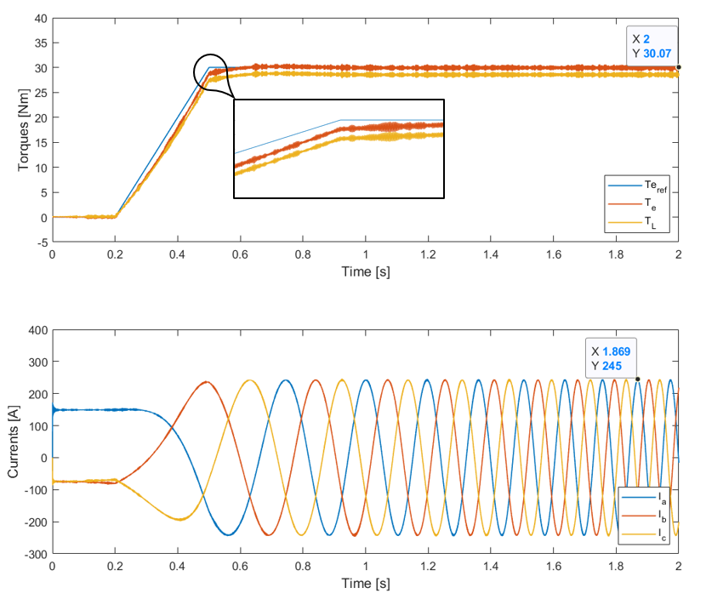
Simulation result
Slide
of 52
Torque Control

Slide 27
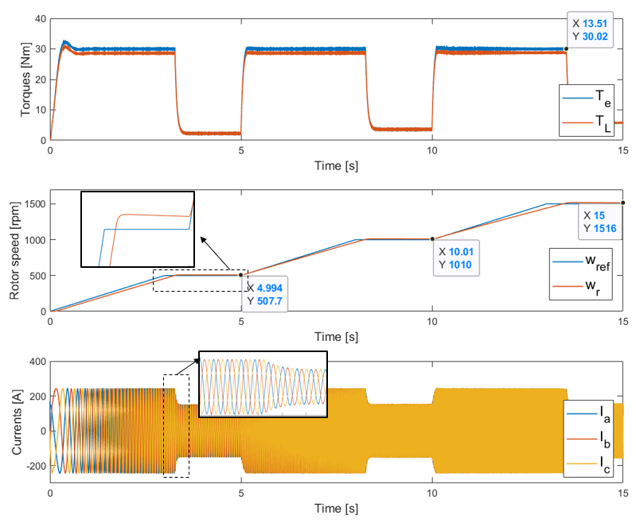
Simulation result
Slide
of 52
Speed Control

Slide 28
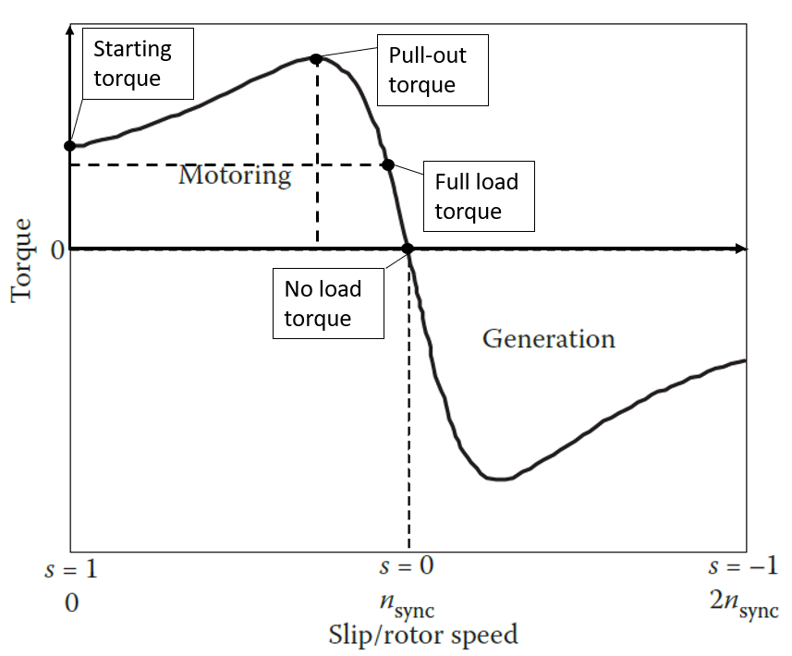
Regenerative braking
Slide
of 52
When the rotor speed is higher than synchronous speed (i.e., negative slip), the machine runs in generation mode
$slip= \frac{n_{sync} − n_{rotor}}{n_{sync}}$
$$n_{rotor}> n_{sync}$$
Negative slip
Negative torque
Faheem

Slide 29
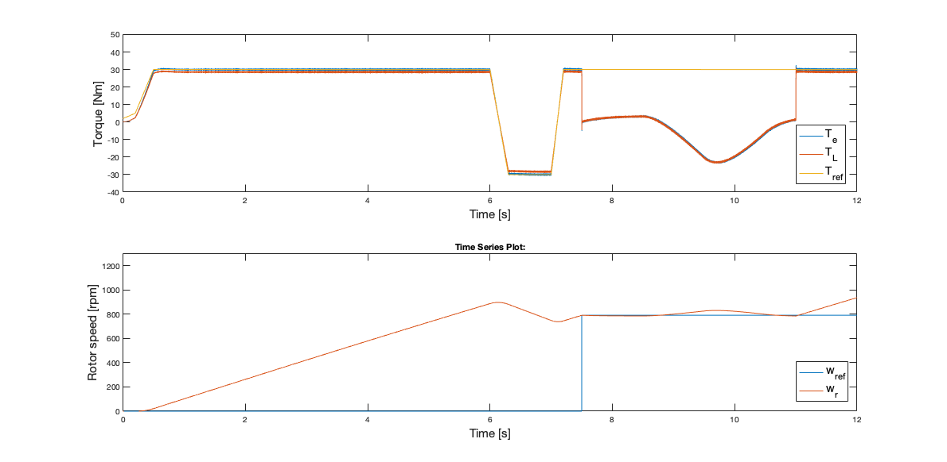
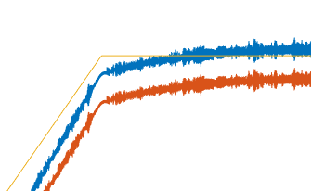
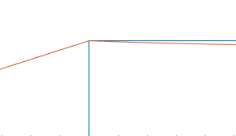
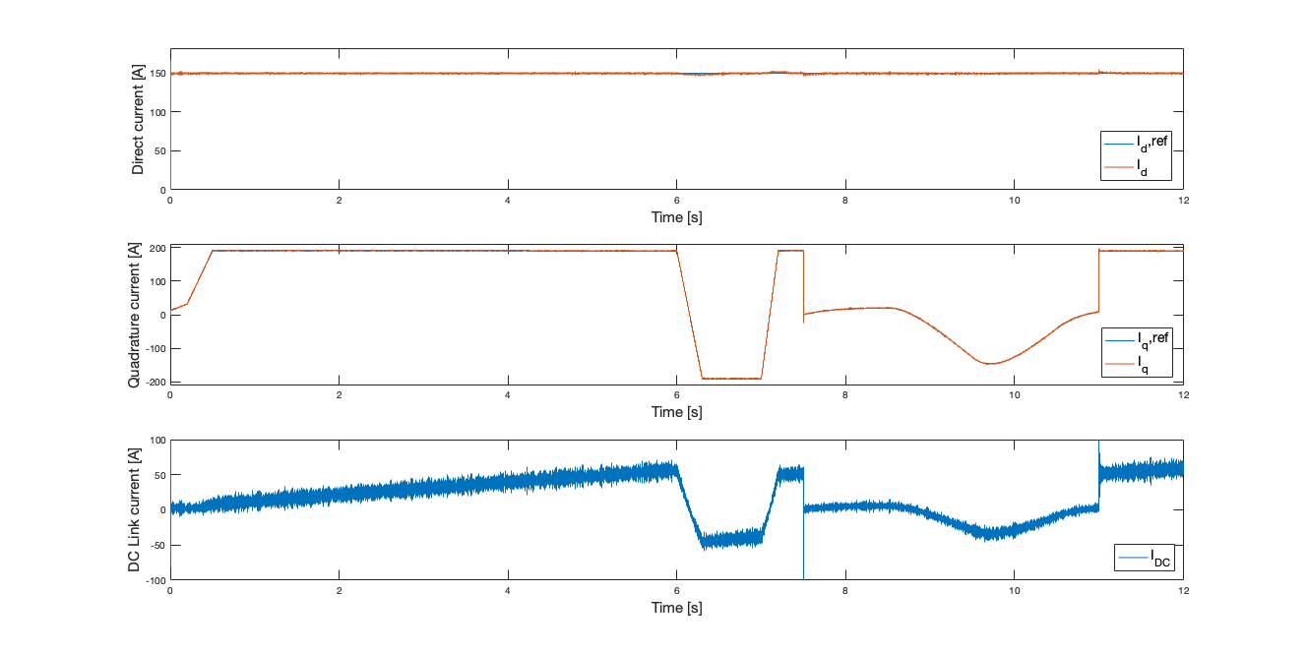
Regenerative braking simulation
Motor stops following torque reference during speed control
Slide
of 52
Downhill slope of 10°
Speed Control Region
Torque Control Region
Both in torque control & speed control
Negative DC link Current

Slide 30
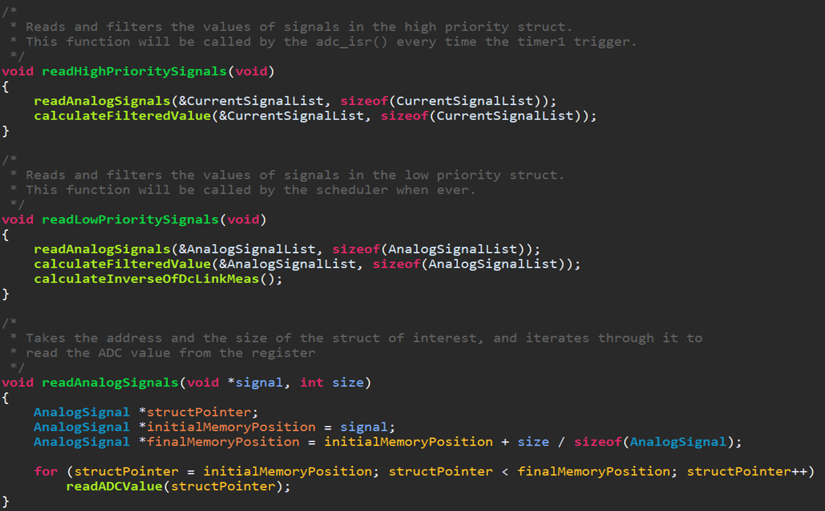
Firmware
Notes:
Motivation
Existing problems
What is a MIC
Why a MIC
Problem statement

Slide 31
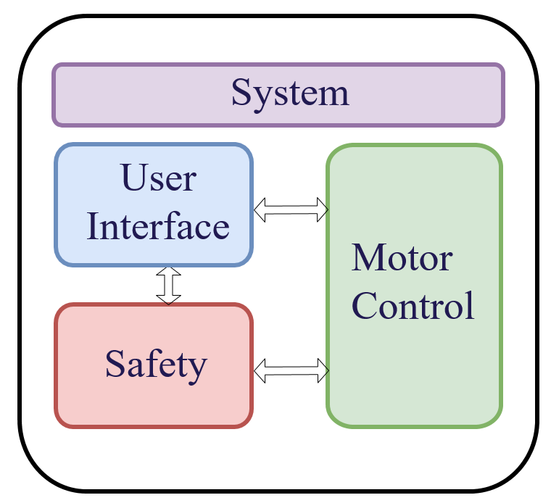
Firmware Design
Slide
of 52
System feature definition
Modular design
Allows collaboration between several developers
Increases scalability
Increases reliability
Allows code reusability
High level design
Low level design
Nicolás

Slide 32
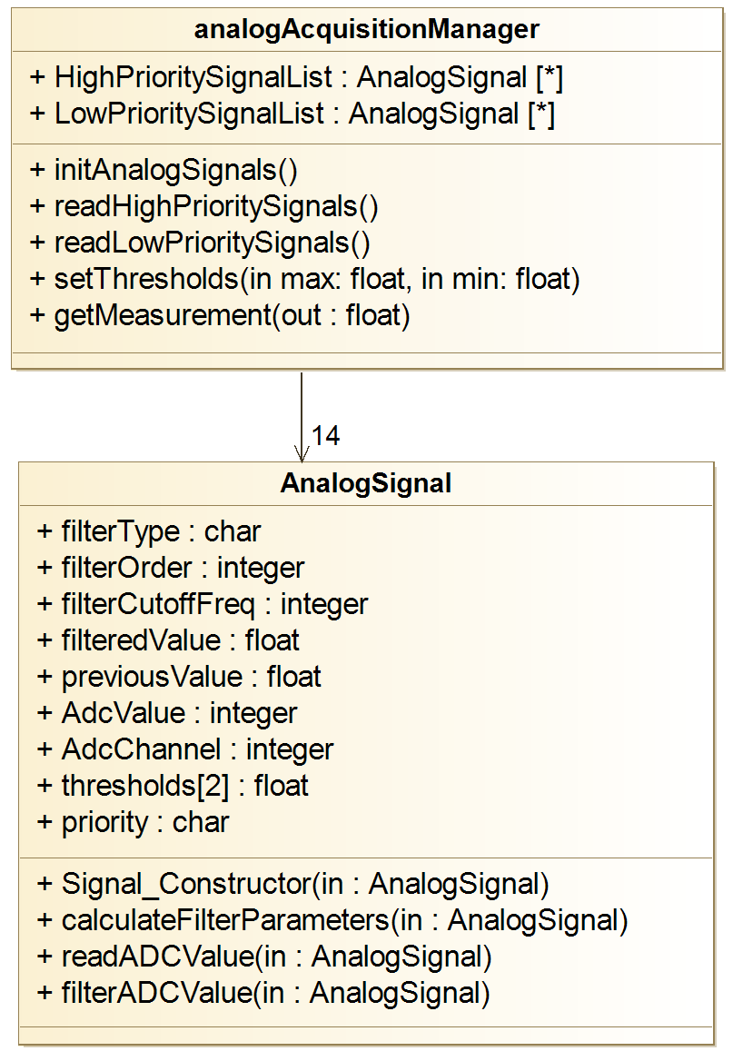
High level design
Slide
Unified Modeling Language (UML)
of 52
For every software module
What is its goal?
When should the task be performed?
How will it interact with other modules?
Goal
Understand the big picture of the system
Nicolás

Slide 33
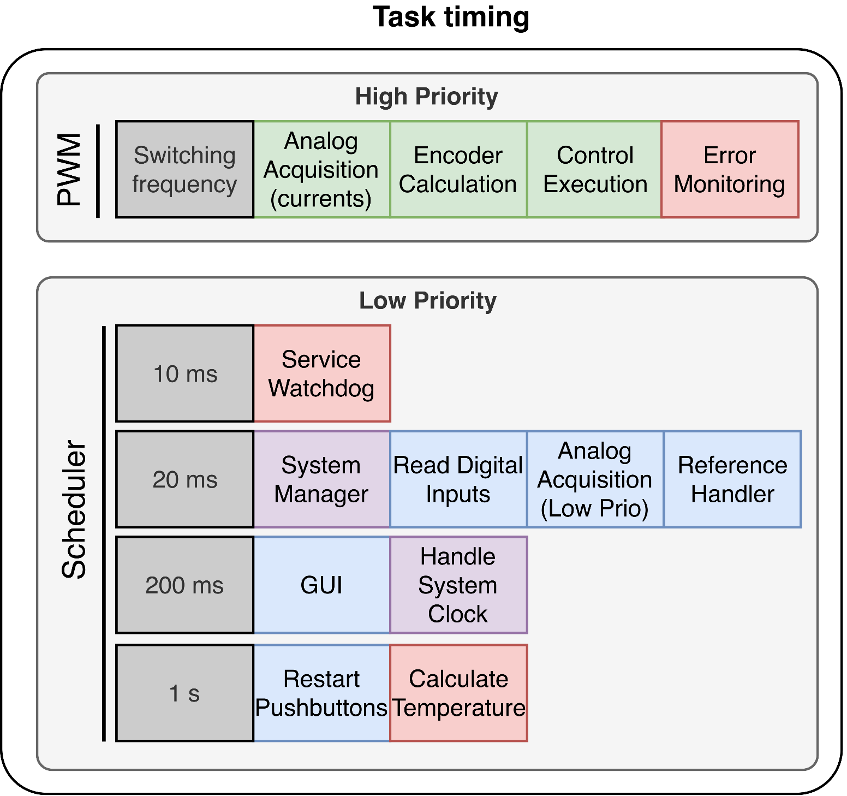
High level design - Timing
Slide
of 52
Real time system: Time constraints
Motor control: calculation of new duty cycle every switching period
Other modules → Scheduler
Scheduler
Critical module
Calls tasks with different cyclicity
Nicolás

Slide 34
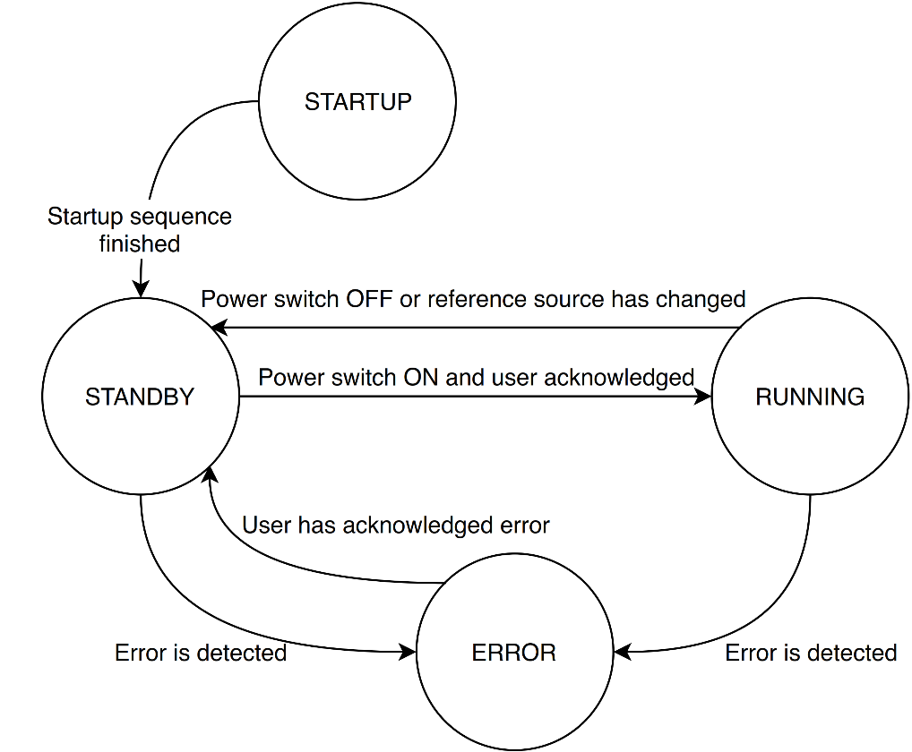
Low level design
Slide
of 52
For every software module
Detailed explanation of module
Suggested data types, algorithms or patterns
Goal
Find technical limitations of the system
Speed up the development phase
Nicolás

Slide 35
System
Slide
of 52
System are those modules which provide a framework for other modules
System Manager System supervision
Scheduler Task timing framework
Logger Debugging framework
Nicolás

Slide 36
System manager
Slide
of 52
Features
System status
User interaction
Nicolás

Slide 37
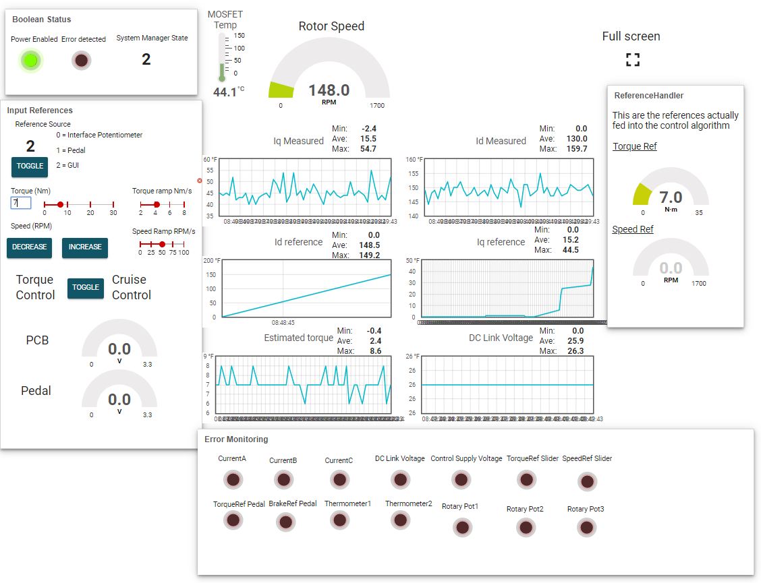
User interface
Slide
of 52
Different sources
Interface PCB
Graphical User Interface
Go-kart pedal
Reference Handler
Nicolás

Slide 38
Motor control
Slide
of 52
Position estimation
Analog signal acquisition
Closed loop algorithm
Nicolai

Slide 39
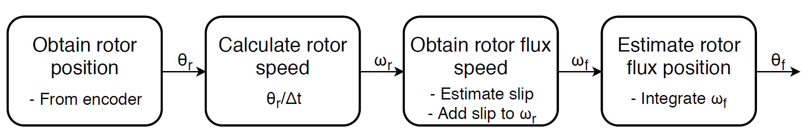
Position estimation
Slide
of 52
Nicolai
Notes:
Calculate position from amount of pulses received
Calculate speed from the position change every 30 electrical degrees or within a specified time period (If speed is slow)
Slip speed is estimated from Machine parameters and dq-current references
Rotor flux speed is found by adding the shaft speed and the slip speed.
Integrated to optain estimated flux position, used for reference frame transformations

Slide 40
Analog signal acquisition
Slide
of 52
Analog signal structure
Raw ADC value
Filtered value
Previous value
Filter order
Filter frequency
Filter parameters
ADC channel
Priority
Safety thresholds
Interface functions
Nicolai

Slide 41
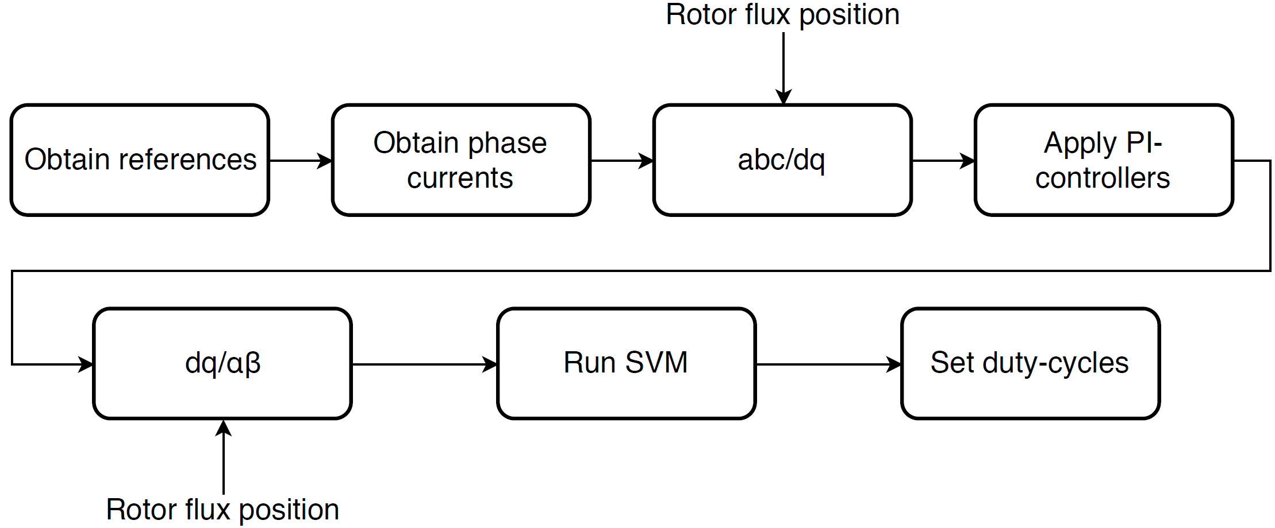
Closed loop control algorithm
Slide
of 52
50µs
Nicolai

Slide 42
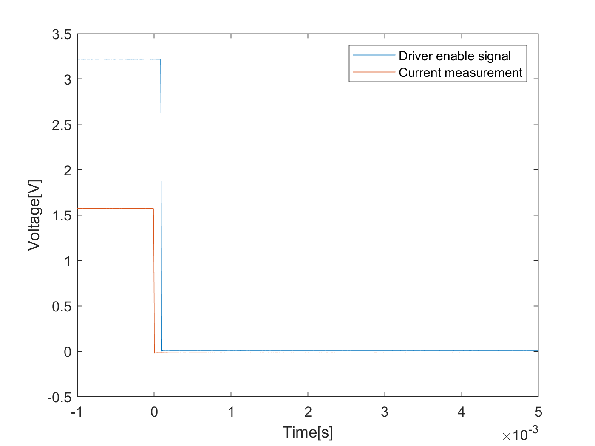
Safety
Slide
of 52
Monitors possible error sources
Overvoltage
Overcurrent
Temperatures
Performs the necessary safety reaction
Includes a watchdog timer
Nicolai

Slide 43
System tests

Slide 44
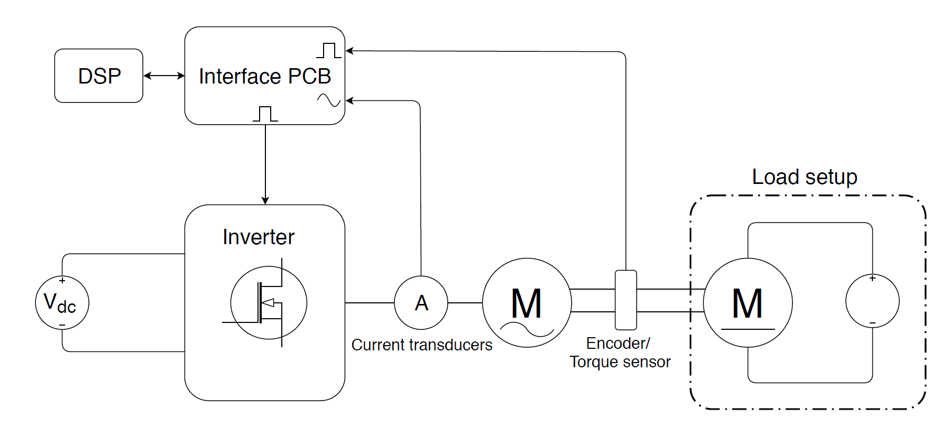
Test setup
Slide
of 52
Nicolai

Slide 45
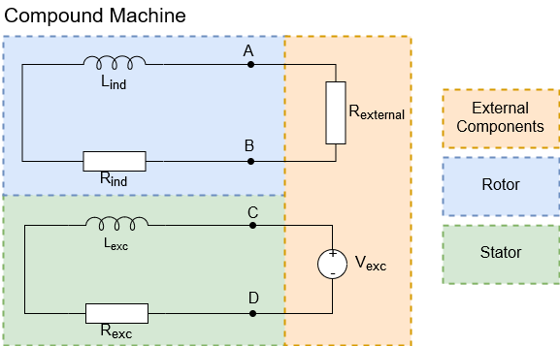
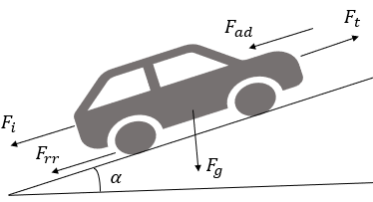
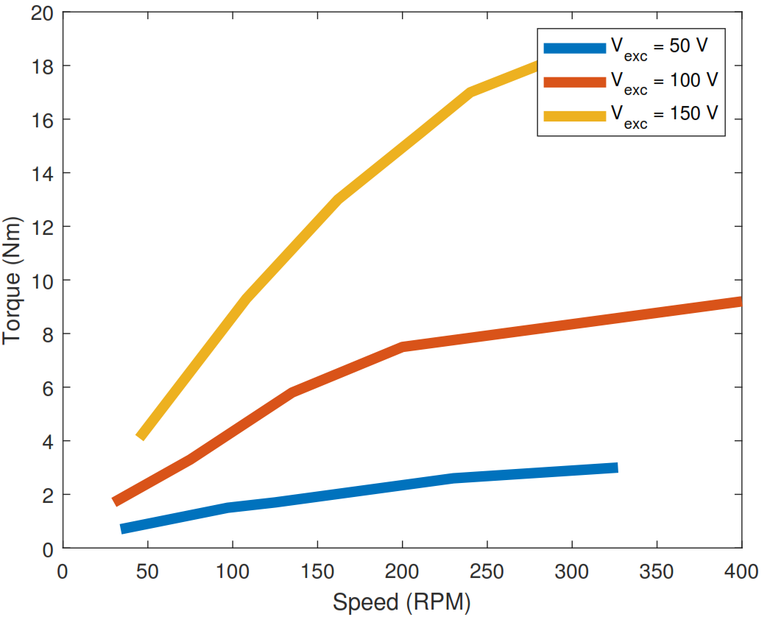
Load difference
Slide 45
Load motor
of 52
Go-kart load
Aitor
Notes:
Simulation results are also different.
Mechanical model is completely different, which affects speed load but not torque reference due to similar RL load.
Mention PI parameters are different than in simulation.

Slide 46
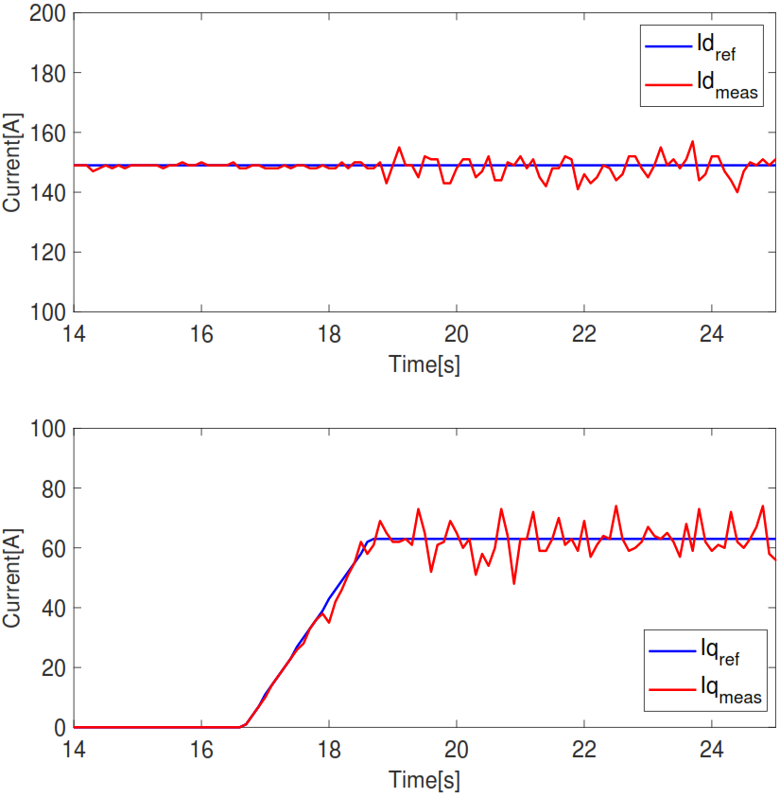
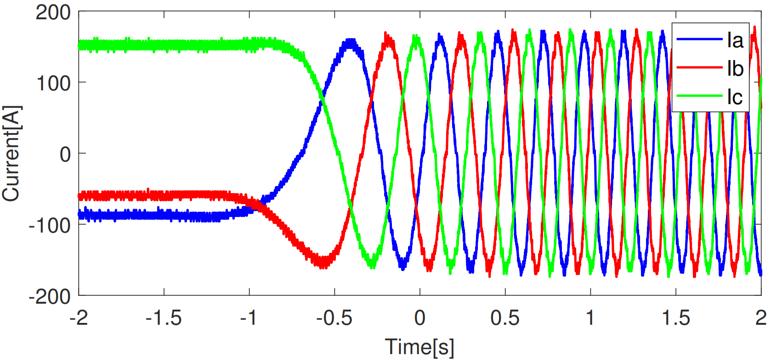
Torque control - Startup
Slide 46
of 52
Aitor

Slide 47
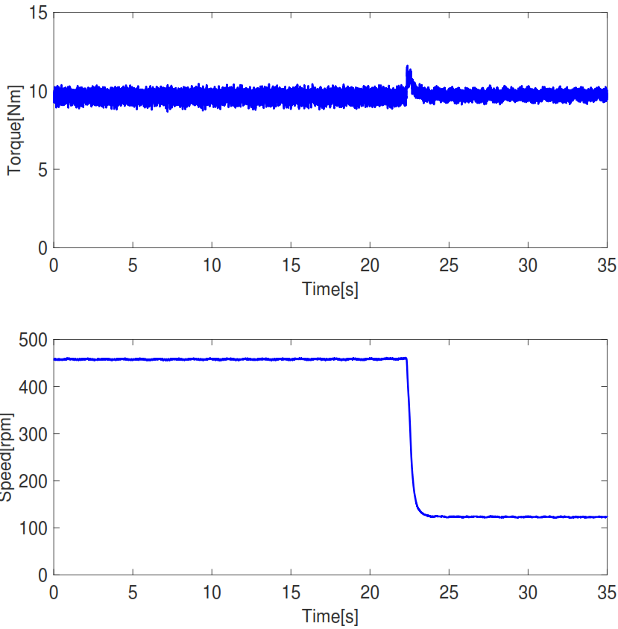
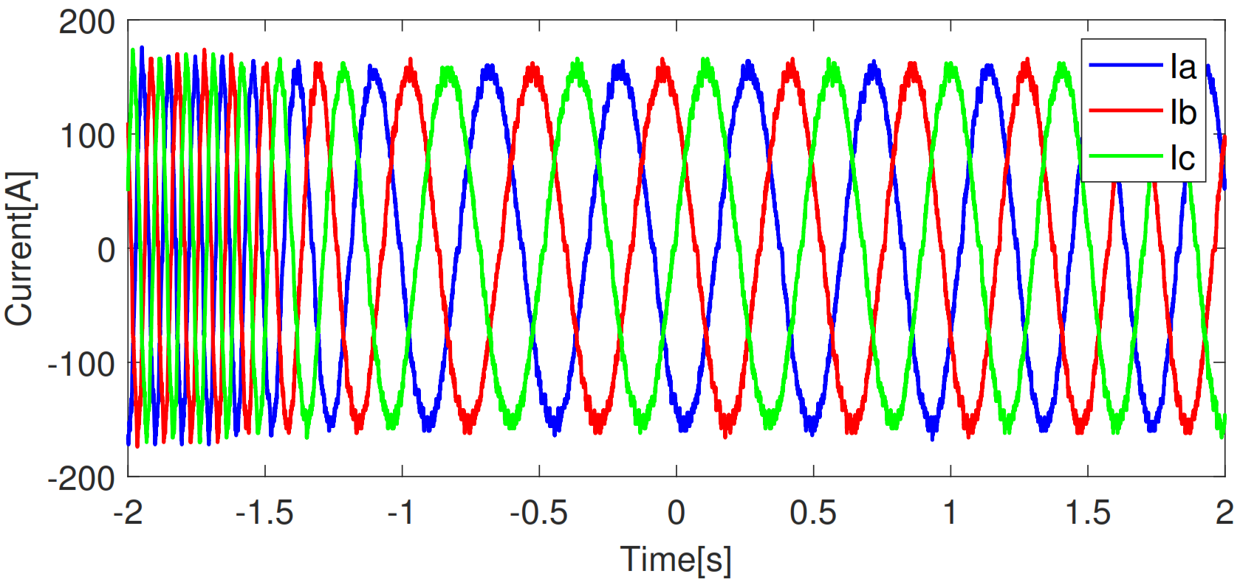
Torque control – Load change
Slide 47
of 52
Aitor
Notes:
Explain the change on speed in the right

Slide 48
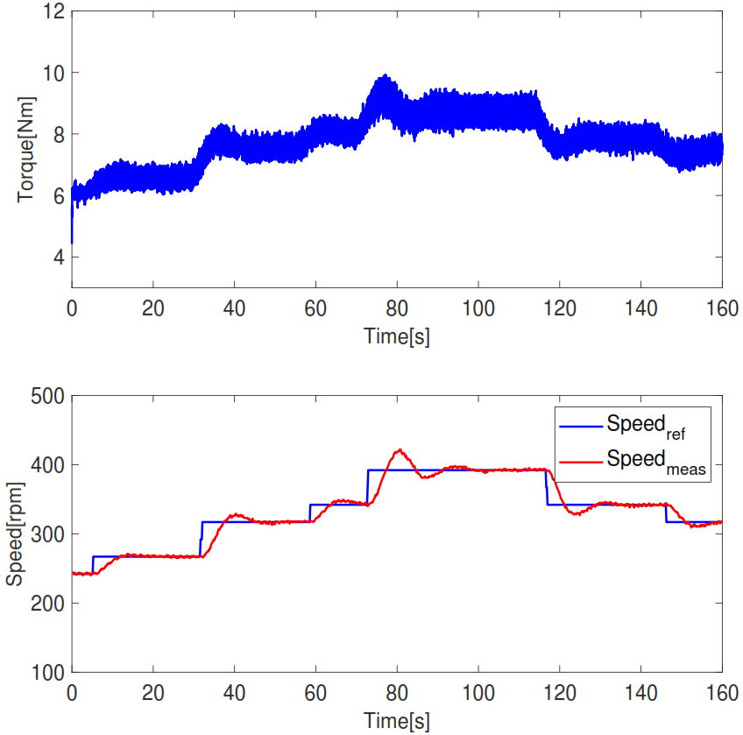
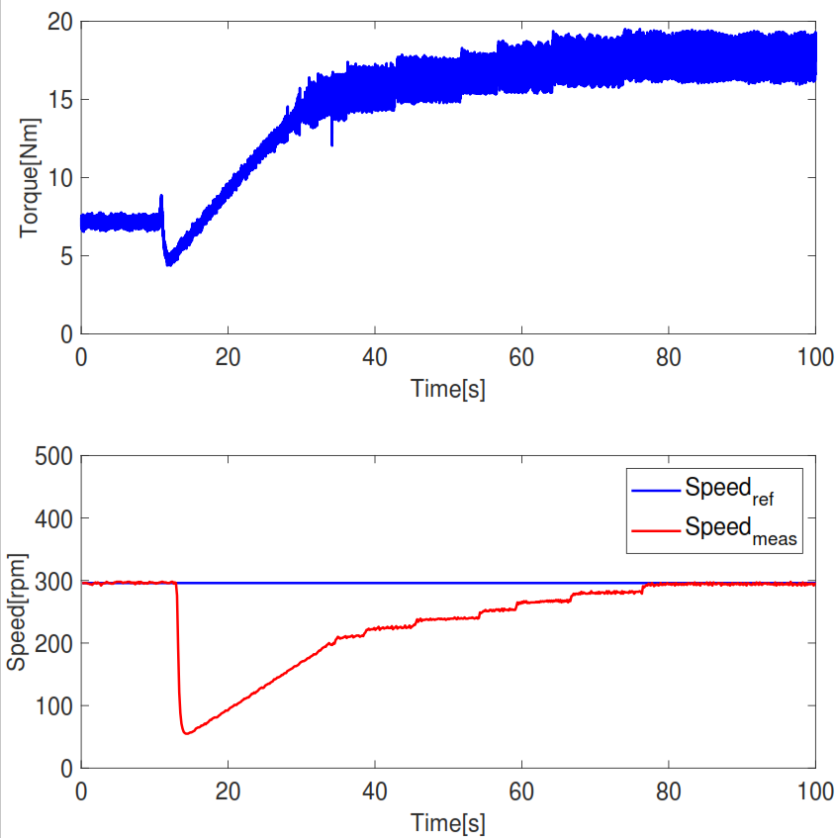
Speed control
Slide 48
of 52
Speed variation
Load variation
Aitor
Notes:
Do not say real life, say tests, experimental…
Speed control is not quick, it’s actually slow.
Also talk about inertia here.
Not say actually and oscillations, more overshoot.
Steps of 25 or 50.

Slide 49


Torque to speed transition
Slide 49
of 52
Simulation
Tests
Aitor
Notes:
PI error is zero at the beginning and so torque ref goes down to zero, inertia helps stabilizing.
GENERAL: Overview slide in the beginning.

Slide 50

Future work
Slide 50
of 52
Alternative approach in field oriented control
Implementation of regenerative braking
Performance at higher switching frequency
Integrating the power train in the go-kart platform
Aitor
Notes:
Add arrows.

Slide 51
Conclusions
Slide 51
of 52
Positive outcome
Simulation to implementation
Project management
Aitor
Notes:
Add technical conclusions.
Change for arrows.

Slide 52
Thank you for your attention
Questions?
Notes:
Add technical conclusions.
Change for arrows.

